Slide 1
Simple Ways to Make Jesus
“Findable” to others.

Slide 2
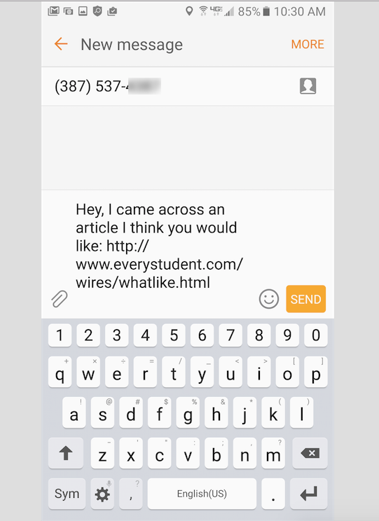

Slide 3
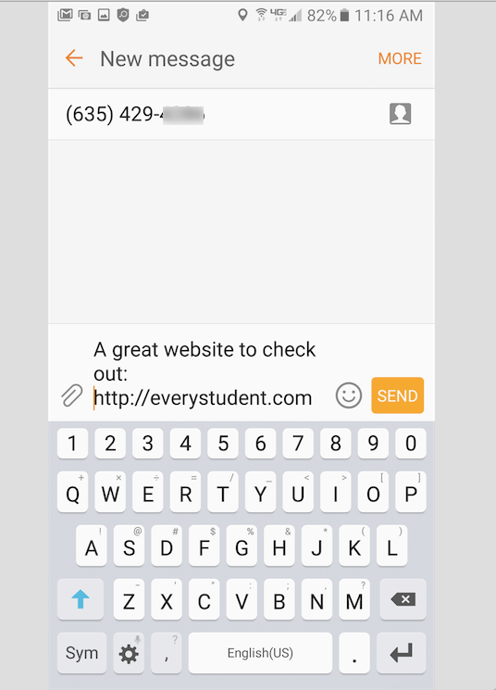

Slide 4
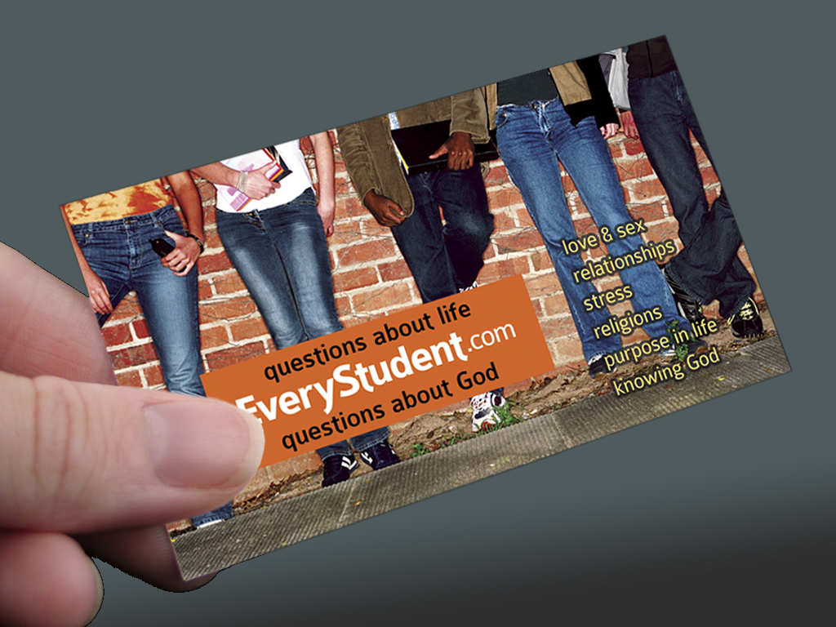

Slide 5
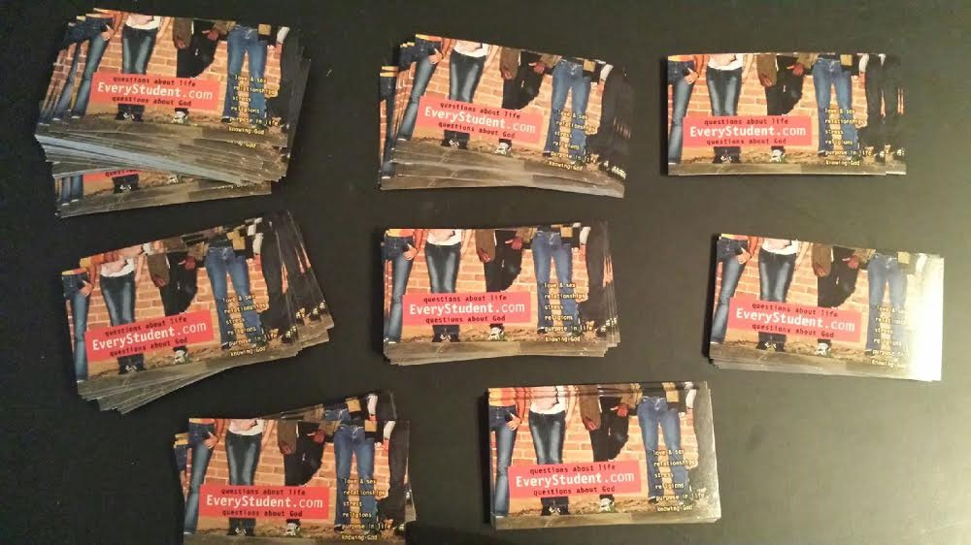

Slide 6
“I took 3 cards, and had 3 conversations today.
It was so easy!!”

Slide 7
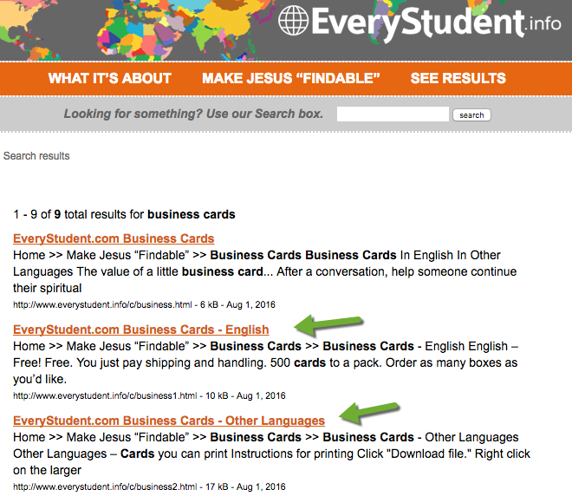
Enter in search box: business cards

Slide 8

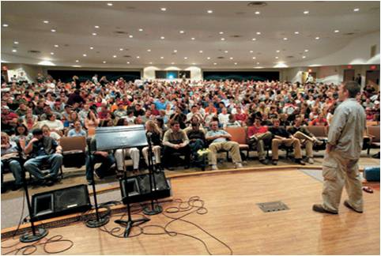


Slide 9
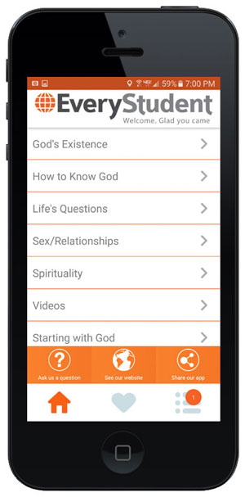
In iPhone and Android app stores.
Search: Every Student

Slide 10
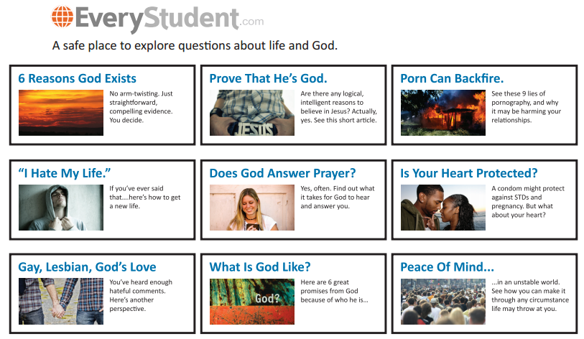
Hand out this flier.

Slide 11
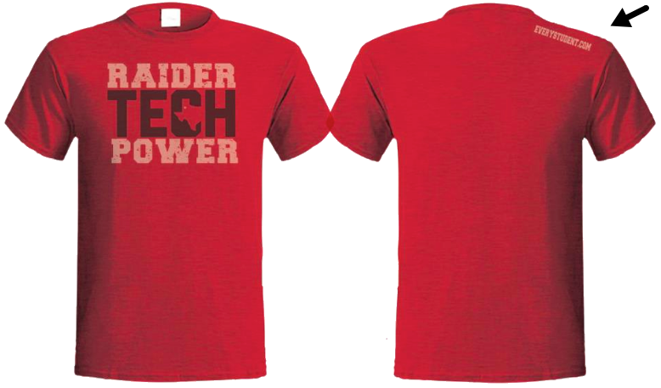
T-shirts

Slide 12
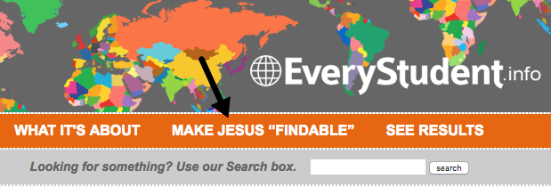
More ideas here…

